Slide 1
IBM HR ANALYTIC DATASET ISDS-574
By: Group 6
Gurleen Kaur
Aniket Shete
Manali Joshi
Baljinder Sandhu
Abhishek Rai
Rathin Deshpande
Nikita Urunkar

Slide 2
Agenda
Introduction: Goal, Research Question, Dataset Description
Data Preprocessing and Exploration
Data Mining methodologies used
Model evaluation and selection
Existing literature
Conclusion

Slide 3
Introduction
GOAL: The goal of this data mining project is to accurately predict employee attrition, so that any organization can take steps to keep their employees happy and less susceptible to competitive overtures as well as save on time and money to hire somebody else.
RESEARCH QUESTIONS: We aim to use the “IBM HR Analytic Employee Attrition and Performance” dataset to build a model in order to get a better explanation of what critical features are linked to employee attrition. Following are some particular questions of interest that we aim to answer by the end of the project:
Does employee attrition depend on Monthly Income?
Does the job satisfaction rate depend on the job level? If yes, do these factors have an effect on the employee attrition rate?
Do the employees associated with an organization since a longer time have a lower churn rate as compared to the ones that have been recently hired?
Does a particular department need overtime which results in dissatisfaction among the employees?

Slide 4
Introduction (Cntd.)
DATASET DESCRIPTION: This dataset contains 1470 observations and 35 variables about employee’s demographics, evaluations about the company and attrition result. The original variables of the dataset are as shown below:
Variable Names
Age | EducationField | JobLevel | Over18 | TotalWorkingHours
Attrition | EmployeeCount | JobRole | OverTime | TrainingTimesLastYear
BusinessTravel | EmployeeNumber | JobSatisfaction | PercentSalaryHike | WorkLifeBalance
DailyRate | EnvironmentSatisfaction | MaritalStatus | PerformanceRating | YearsAtCompany
Department | Gender | MonthlyIncome | RelationshipSatisfaction | YearsInCurrentRole
DistanceFromHome | HourlyRate | MonthlyRate | StandardHours | YearsSinceLastPromotion
Education | JobInvolvement | NumCompaniesWorked | StockOptionLevel | YearsWithCurrManager

Slide 5
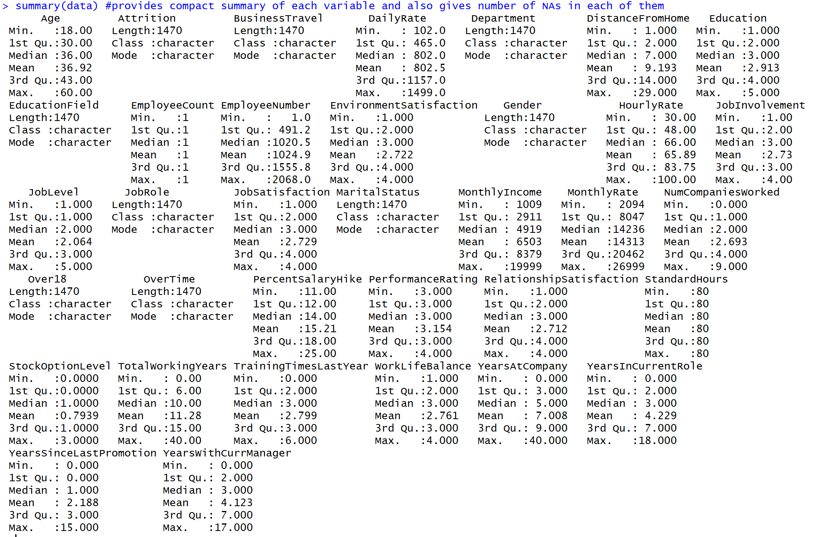
Data Preprocessing and Exploration
SUMMARY:
Descriptive Statistics of Variables

Slide 6
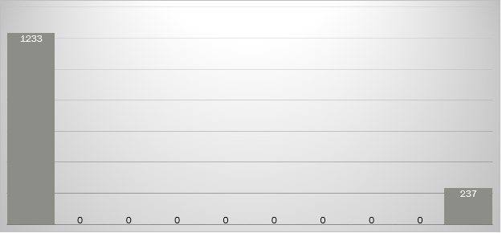
Data Preprocessing and Exploration
SUMMARY:
Distribution of “Attrition” variable: 237 left the company which accounts for almost 16% of the total number of employees.

Slide 7
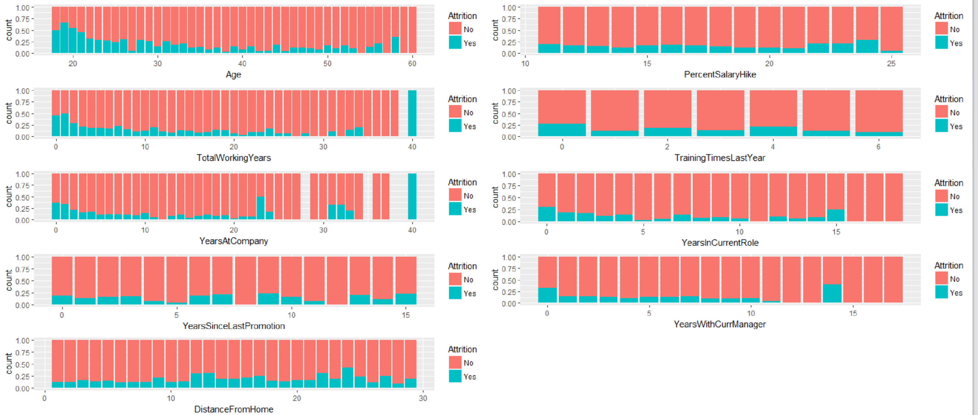
Data Preprocessing and Exploration
DATA VISUALIZATION:
Visualizing Continuous variables against “Attrition”

Slide 8
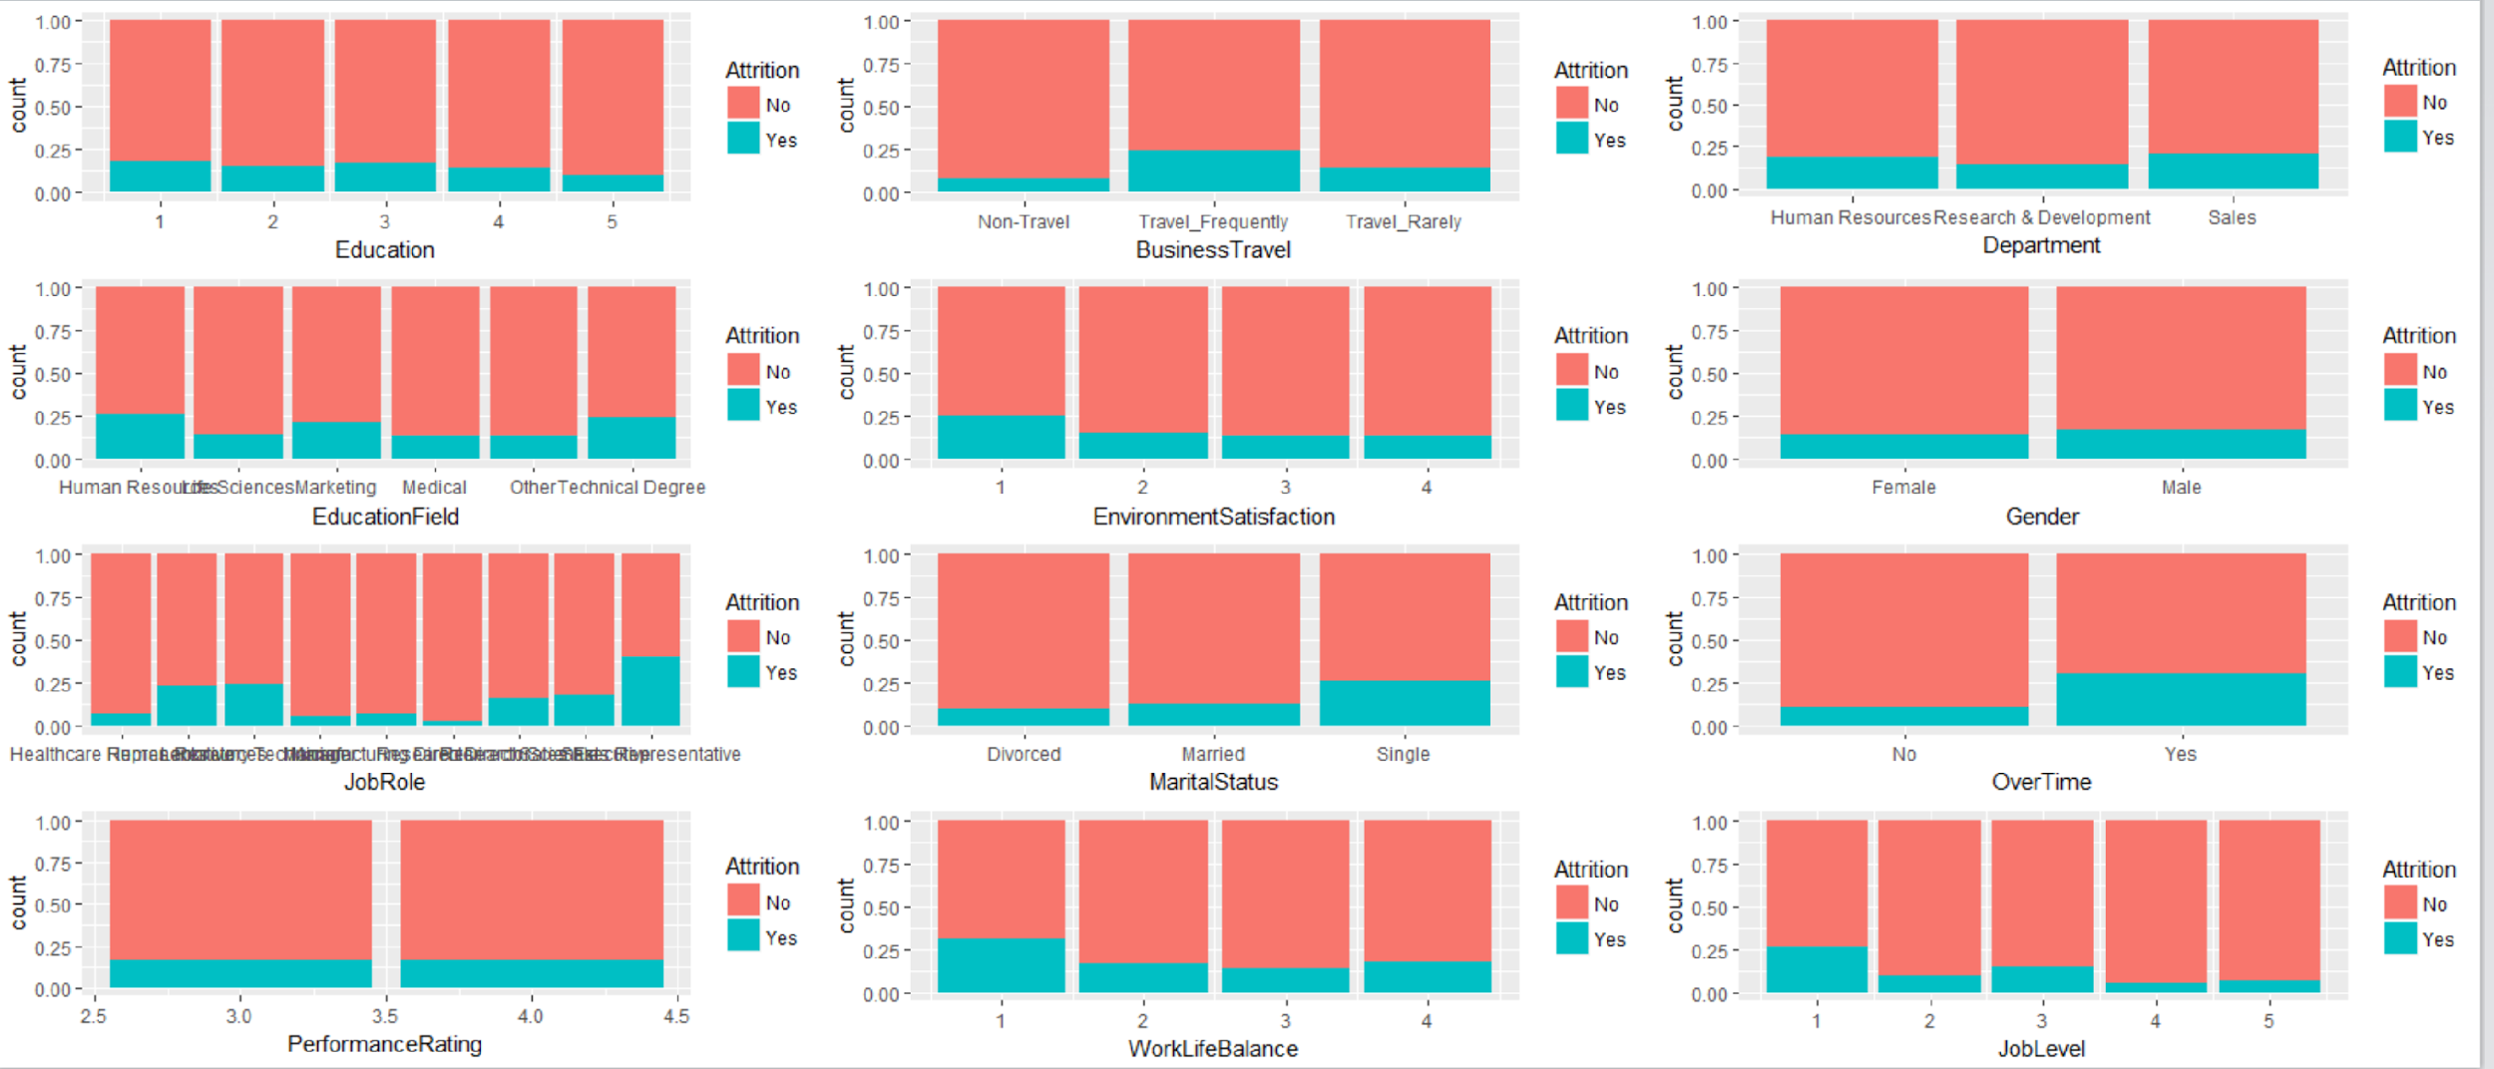
Data Preprocessing and Exploration
DATA VISUALIZATION:
Visualizing categorical variables against “Attrition”

Slide 9
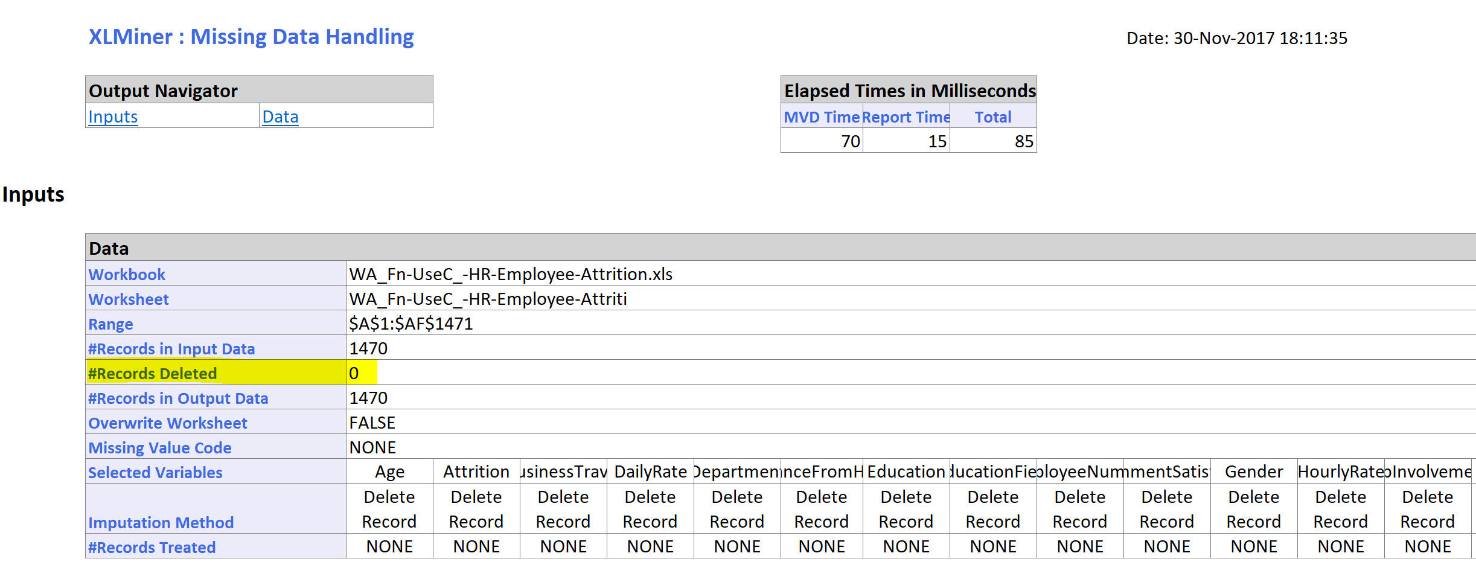
Data Preprocessing and Exploration
DATA CLEANING:
Detecting Missing values: The dataset had no missing values as seen below:

Slide 10
Data Preprocessing and Exploration
Removing insignificant variables: The following variables contain Unary values and are therefore insignificant in contributing to our analysis
Over18
StandardHours
EmployeeCount

Slide 11
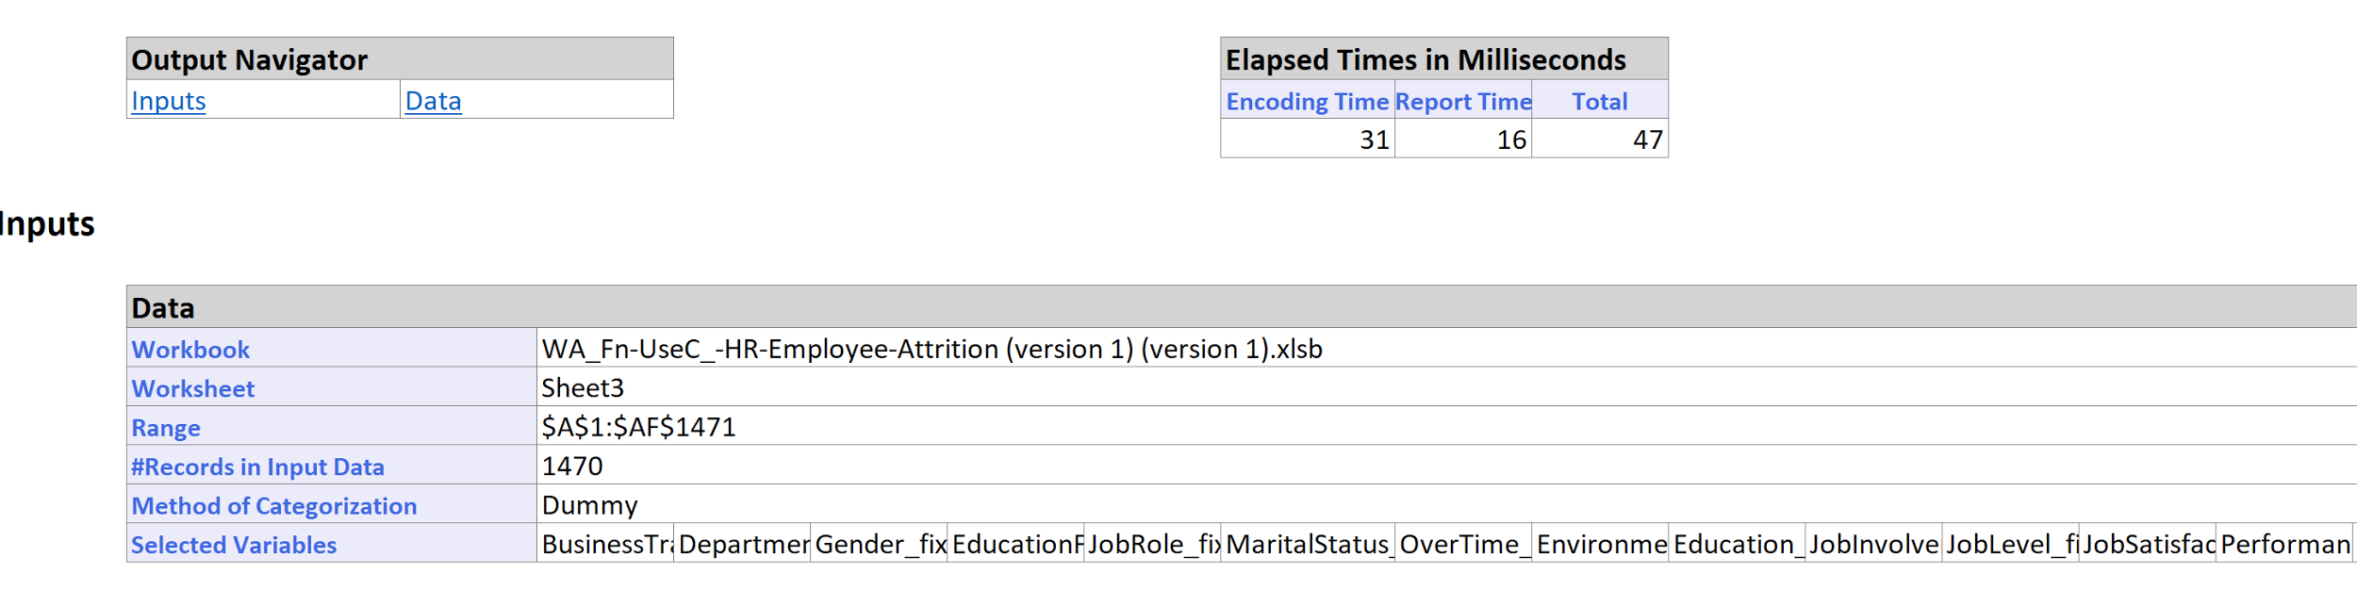
Data Preprocessing and Exploration
Transforming Categorical Variables into Dummies: There are 16 Categorical variables which are converted into dummies for individual values. After the conversion, there are 80 variables in total.

Slide 12
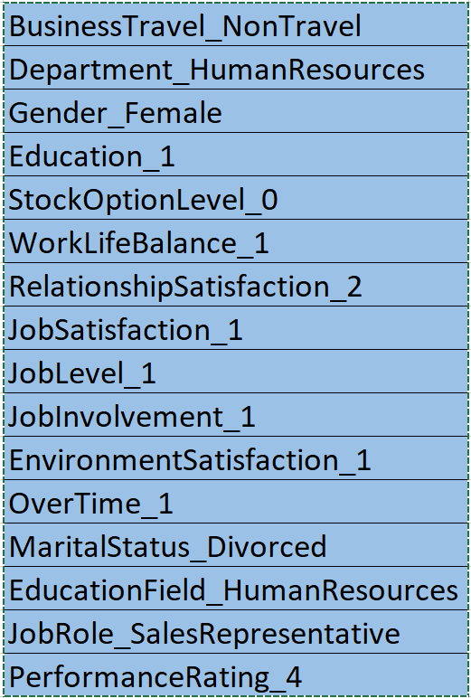
Data Preprocessing and Exploration
Removing reference variables:
The following variables were removed:

Slide 13
Data Preprocessing and Exploration
DIMENSION REDUCTION (Correlation Analysis):
Cutoff: 0.50
24 variables deleted based on this cutoff.
Final dataset consists of 56 variables.

Slide 14
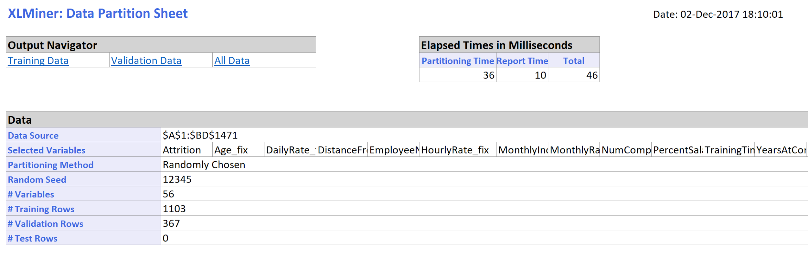
Data Preprocessing and Exploration
PARTITIONING:
75% Training data and 25% Validation data

Slide 15
Data Mining methodologies
CLASSIFICATION ALGORITHMS:
K-Nearest Neighbor
Logistic Regression
Classification Tree

Slide 16
Data Mining methodologies
K-Nearest Neighbor:
■K- Nearest Neighbor algorithm is used for classification of a categorical outcome.
■To classify a new record, this method relies on finding similar records in the training data.
■These neighbors are then used to derive a classification for the new record.

Slide 17
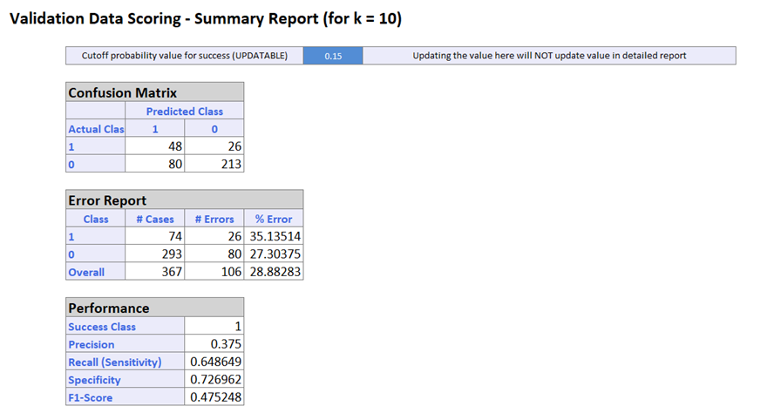
Data Mining methodologies
K-nearest neighbor:

Slide 18
Logistic Regression
Goal: Find characteristics of Employees who are most likely to leave the job at IBM.
Logistic regression is similar to linear regression, except that it is used with a categorical response.
The predictors are related to the response Y via a nonlinear function called the logit
As in linear regression, reducing predictors can be done via variable selection - Forward/ Backward/ Stepwise.
Model is built using training data and tested on validation data

Slide 19
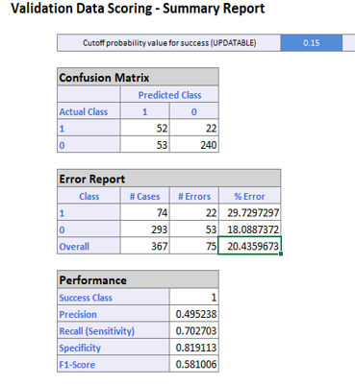
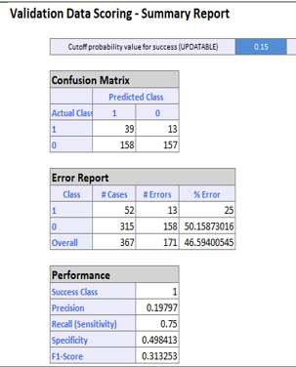
Backward Selection and Stepwise Selection Comparison
Backward Selection Stepwise Selection

Slide 20
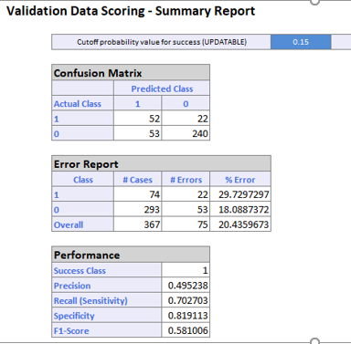
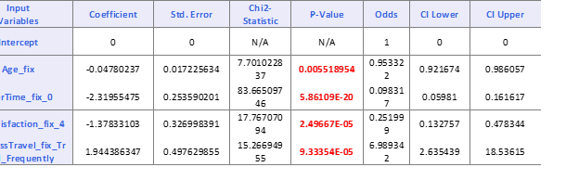
Forward Selection
Performance Measures –
Confusion matrix and misclassification error rate from validation data

Slide 21
Logit Function
Logit = - 0.04780237* Age_fix - 2.31955475* OverTime_fix_0 - 1.37833103* JobSatisfaction_fix_4 + 1.944386347 * BusinessTravel_fix_Travel_Frequently
Interpreting binary predictor effects:
As the Overtime_0 increases that is Overtime is reduced, Attrition rate will decrease by 2.32.
As the Job Satisfaction is high, Attrition rate will decrease by 1.37
As the Business travel_frequently increases, Attrition rate will increase by 1.94
Overtime_0 and Job Satisfaction_4 are associated with employees not leaving the jobs.
Business Travel Frequently is associated with employees leaving the jobs.
Interpreting continuous predictor effects:
As the Age increases, Attrition rate will decrease by 0.047.
Employees with more Age are more likely to stay at their jobs.

Slide 22
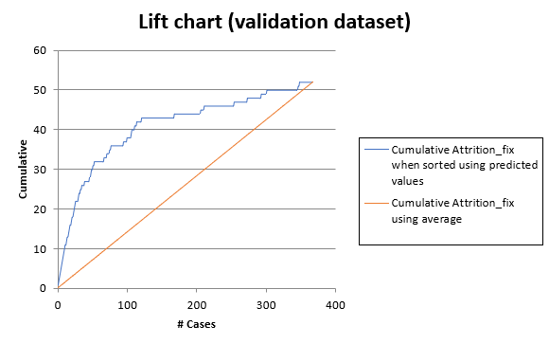
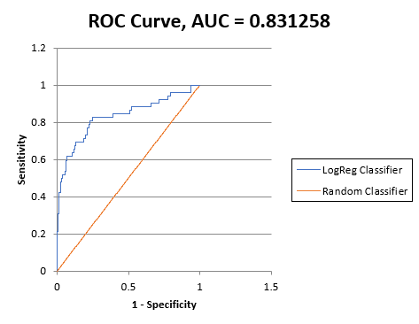
Lift Chart And ROC
Helps determine if the model does a good job of identifying members of a particular class.

Slide 23
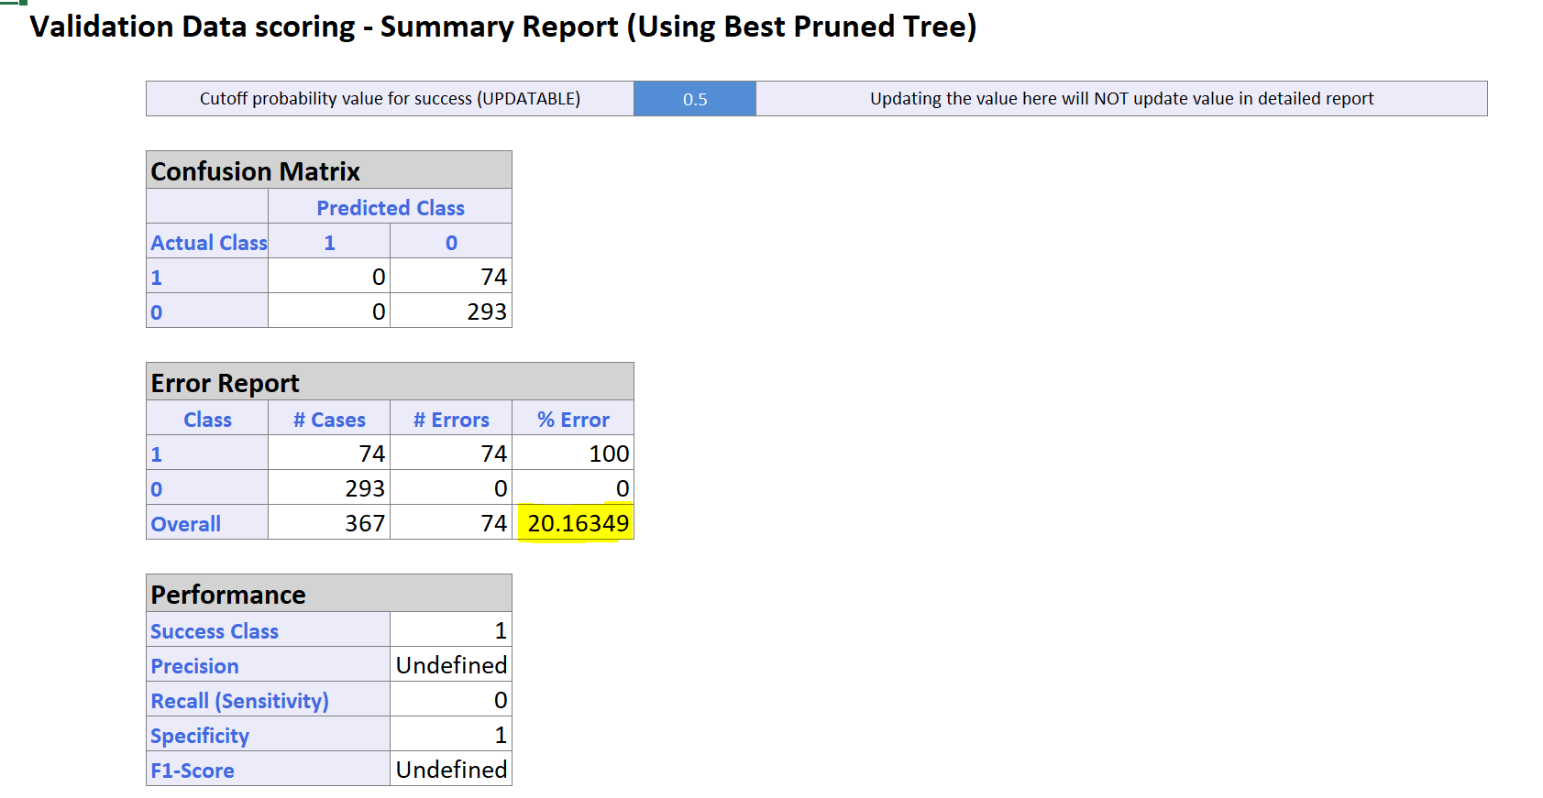
Data mining methodologies
Classification Tree:

Slide 24
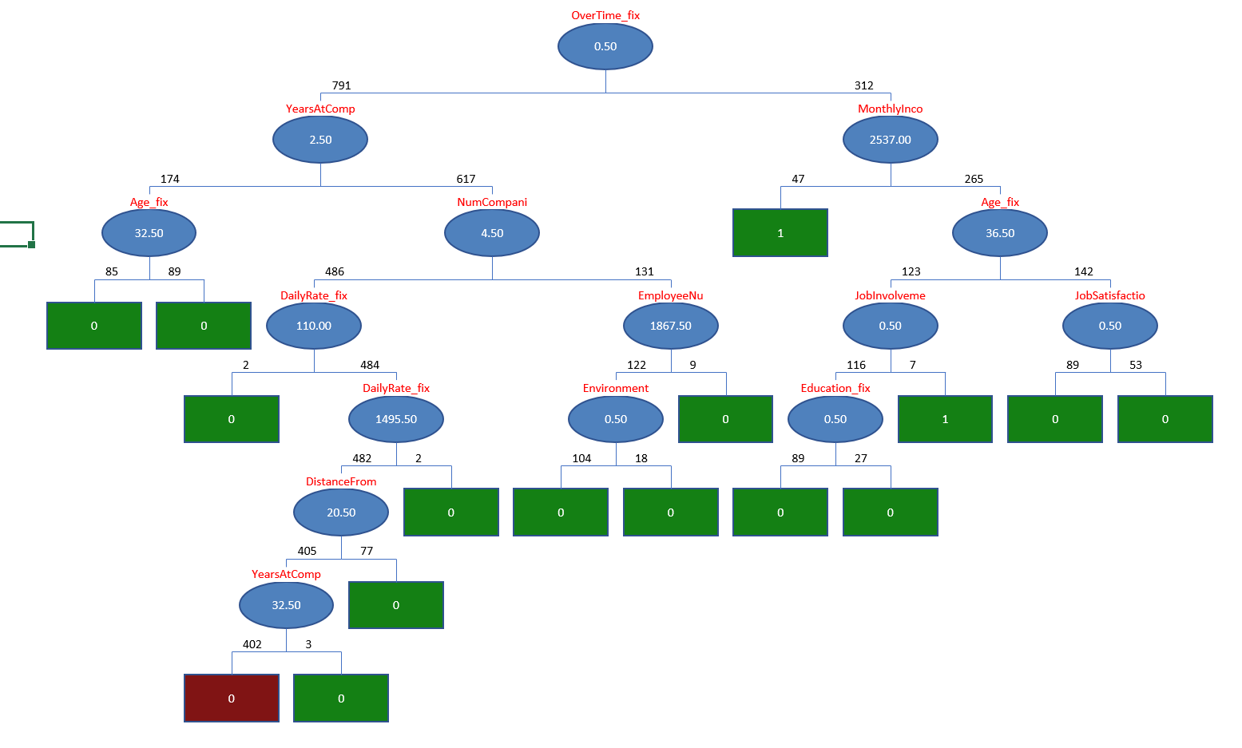
Data mining methodologies
Classification Tree:
Full grown tree:

Slide 25
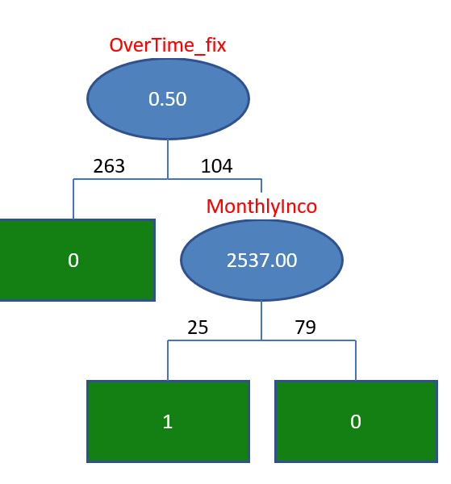
Data mining methodologies
Classification Tree:
Minimum Error Tree:

Slide 26
Data mining methodologies
Classification Tree Interpretation: (based on Minimum Error Tree)
Most important features: Overtime, Monthly Income
Working Overtime does affect satisfaction derived from any job. It should come as no surprise then that our classifier caught onto this and thus ranked this the highest; followed by monthly income obviously.

Slide 27
References of the Existing Literature
IBM employee attrition analysis by Numerics.
https://www.kaggle.com/slamnz/ibm-employee-attrition-analysis-by-numerics
Employee attrition via RF and GBM.
https://www.kaggle.com/arthurtok/employee-attrition-via-rf-gbm
IBM HR Analysis with 90.3% ACC and 89% AUC.
https://www.kaggle.com/esmaeil391/ibm-hr-analysis-with-90-3-acc-and-89-auc

Slide 28
IBM Employee Attrition analysis by Numerics:
What are common characteristics of employees lost in attrition compared to those who stay in IBM's fictional dataset?
Performed the analysis using Python.
Focused on visualizations
Used point plots, box plots, kernel density diagrams, means, standard deviations, and z-tests to explore this question.

Slide 29
Statistically Significant Numerical Features
The fictional company on average loses staff that are 3 - 4 years younger than those who stay.
Employees lost in attrition tend to have lower daily rates than those who stay.
Employees lost in attrition tend to have longer commute distances than those who stay.
Employees lost in attrition are less satisfied with their work environment on average than those who stay.
Employees lost in attrition tend to be lower in job level than those who stay.
Employees lost in attrition tend to have lower monthly average income on average than those who stay.
Employees lost in attrition had poorer work-life balance on average than those who stay.

Slide 30
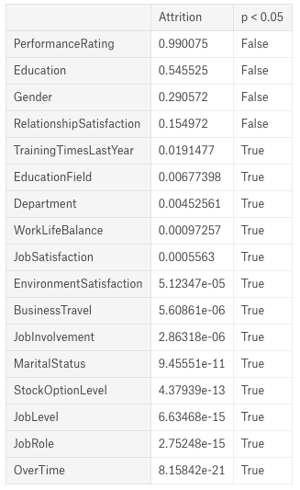

Slide 31
Employee attrition by RF & GBM:
Used predictive modelling to predict employee attrition on this IBM dataset.
Exploratory data analysis – In this technique they lookout at the feature distributions that how one feature is correlated to other.
Data quality checks : to look for any null values.
Correlation Matrix: how features are related to one another.
Categorical Encoding– Encode all the categorical features into dummy variables.
Finally they have implemented the Machine learning models by splitting the data set into training and test datasets.
Used Random Forest model for prediction.
88% accuracy.
Overtime affects highest followed by marital status.
Notes:
Random Forest gathers a group (or ensemble) of decision trees and uses their combined predictive capabilities to obtain relatively strong predictive performance - "strong learner”.
On first glance this might seem to be a very good performing model. However when we think about how skewed our target variable where the distribution of yes and no's are 84% and 26%, therefore our model is only predicting slightly better than random guessing

Slide 32
IBM HR Analysis with 90.3% ACC and 89% AUC:
To predict if an employee is going to resign or not using R.
Removing all previous variables -> Reading data -> Viewing the data -> Summarize the data with 1470 observations and 35 variables -> Check for missing values -> Check for duplicate records.
Visualizations based on different attributes like age, Monthly income, marital status, etc.
Used Random Forest model for prediction.
Correlation matrix of data
Accuracy 90.3% and AUC 89%.

Slide 33
Conclusion
Data mining task undertaken by the team has been thorough and successful.
Data exploration helped in finding uncovered patterns and relationships between the predictors.
Dimension reduction was done by Correlation Analysis.
After we had significant set of predictors, various Classification algorithms were applied in order to answer the Research questions.

